Slide 1
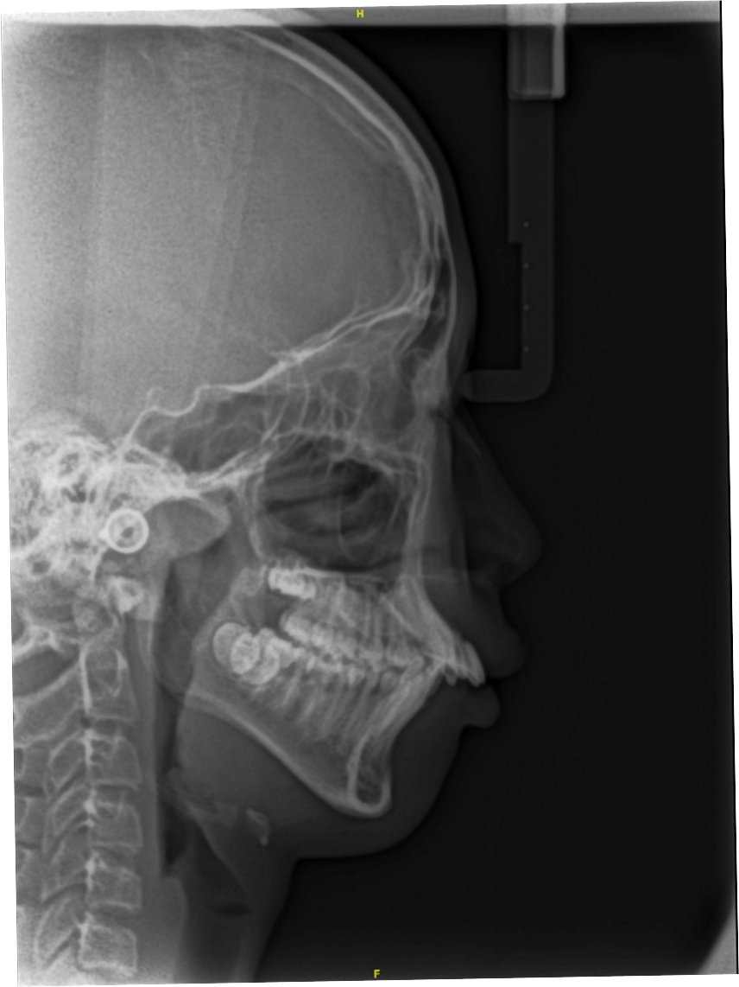
#1

Slide 2
#1

Slide 3
#1

Slide 4
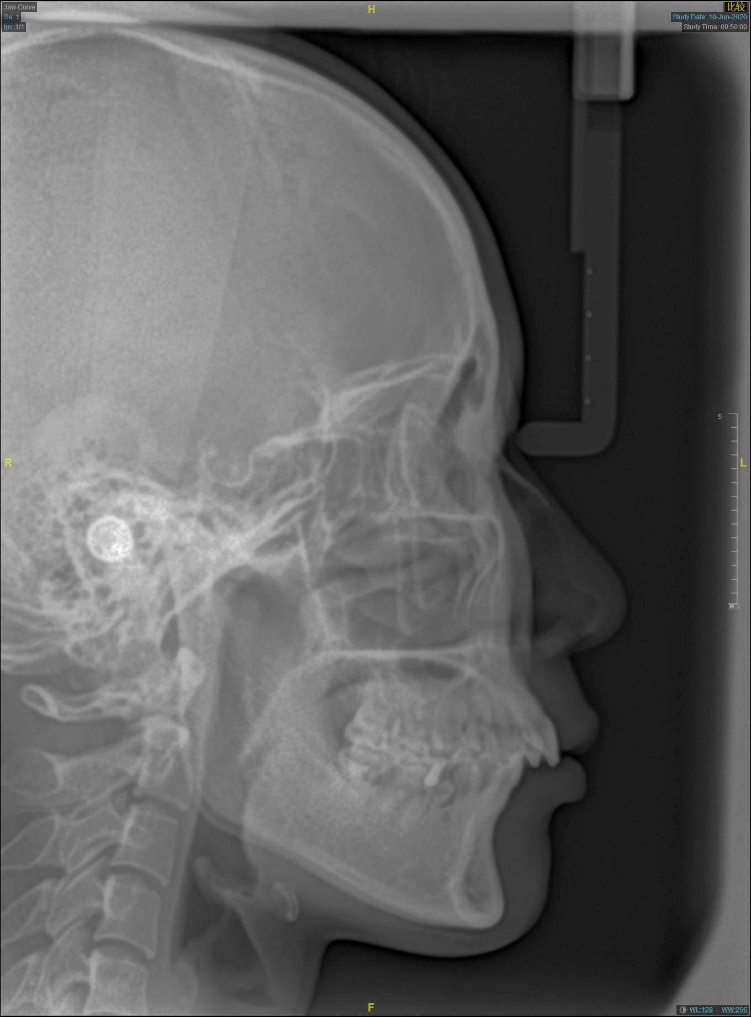
#2

Slide 5
#2

Slide 6
#2

Slide 7
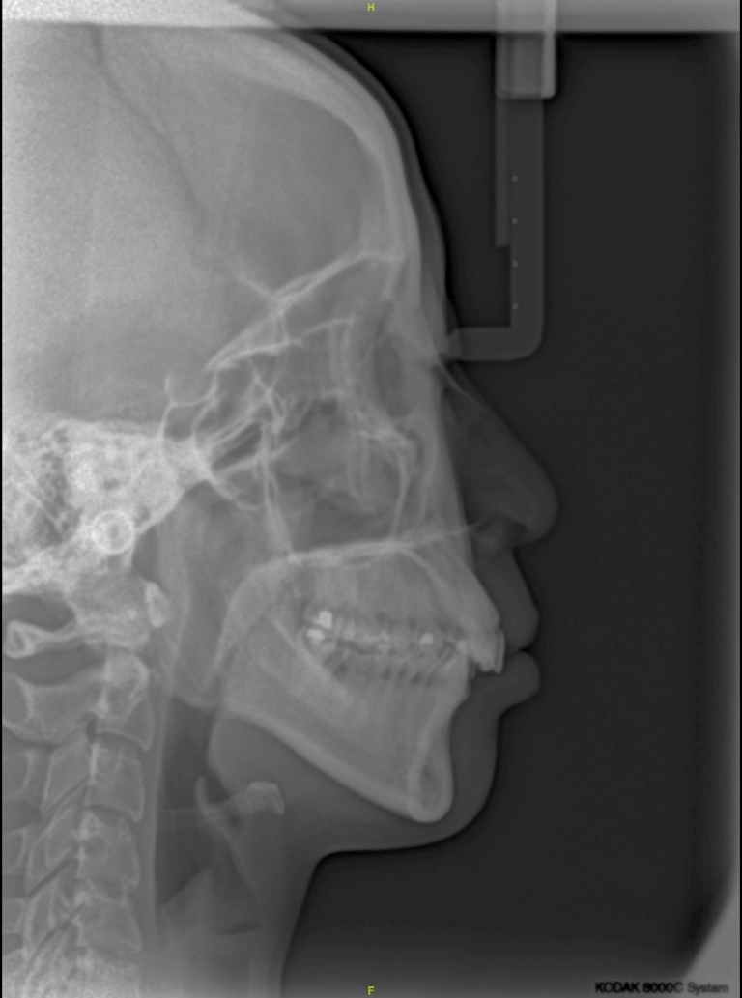
#3

Slide 8
#3

Slide 9
#3

Slide 10
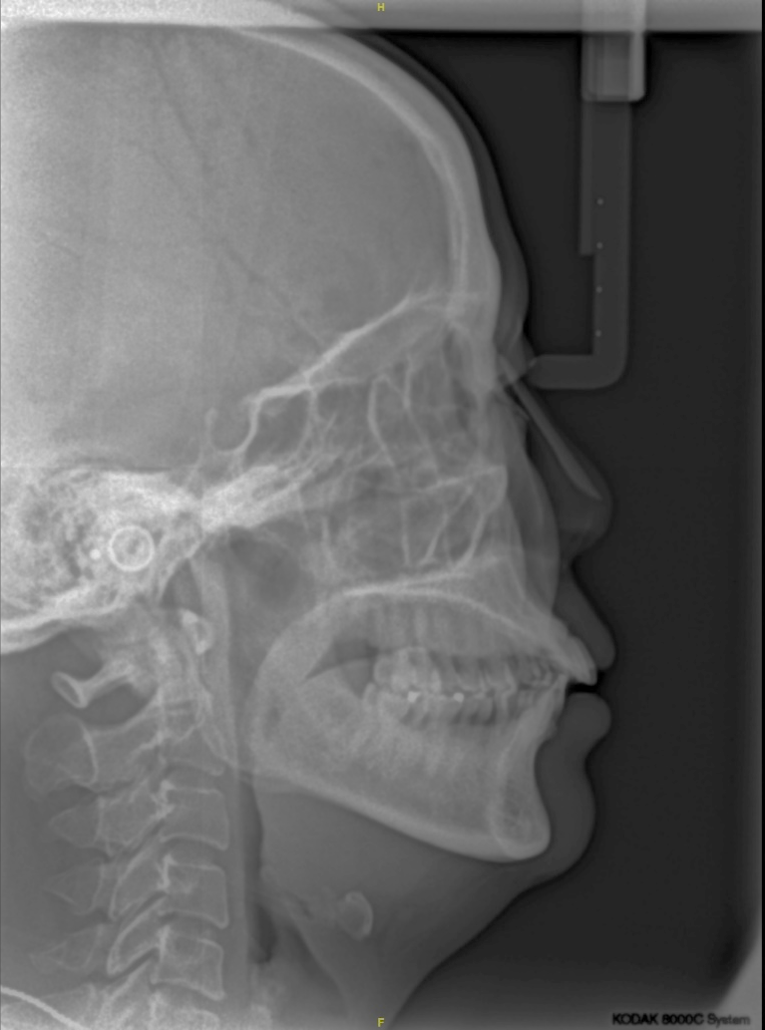
#4

Slide 11
#4

Slide 12
#4

Slide 13
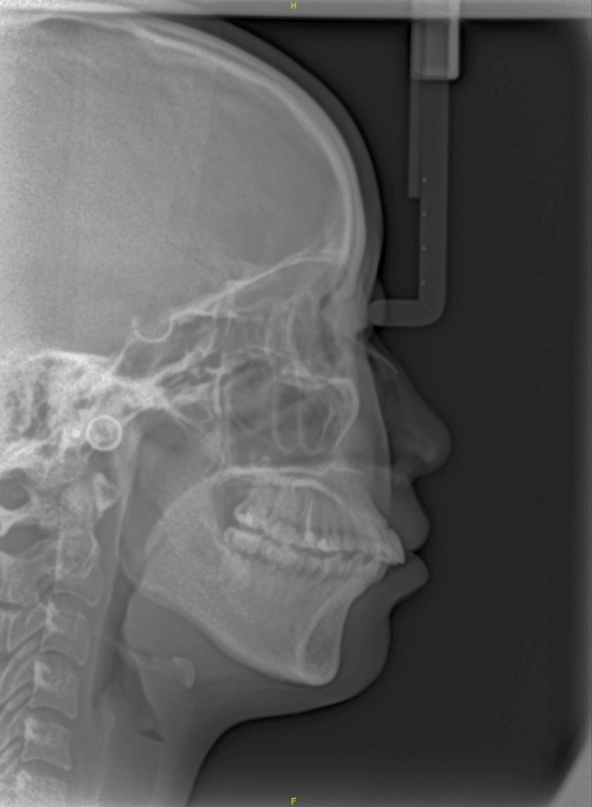
#5

Slide 14
#5

Slide 15
#5

Slide 16
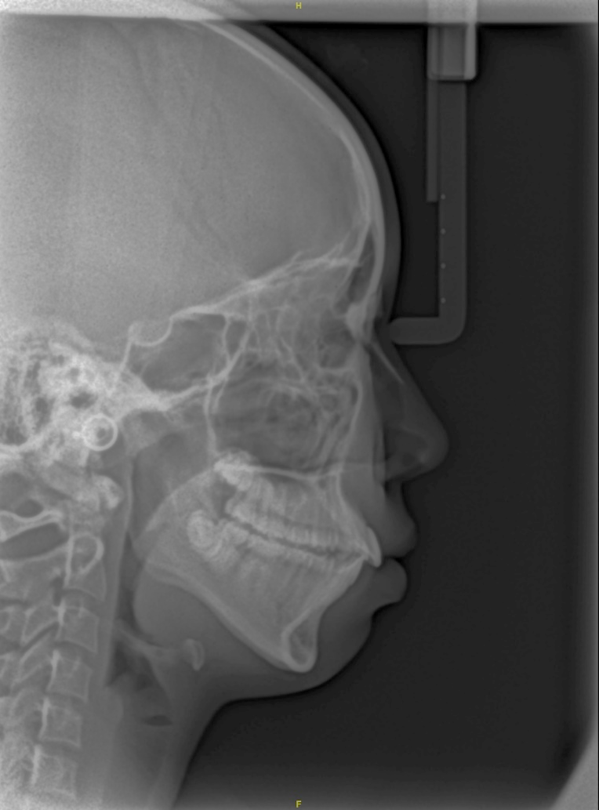
#6

Slide 17
#6

Slide 18
#6

Slide 19
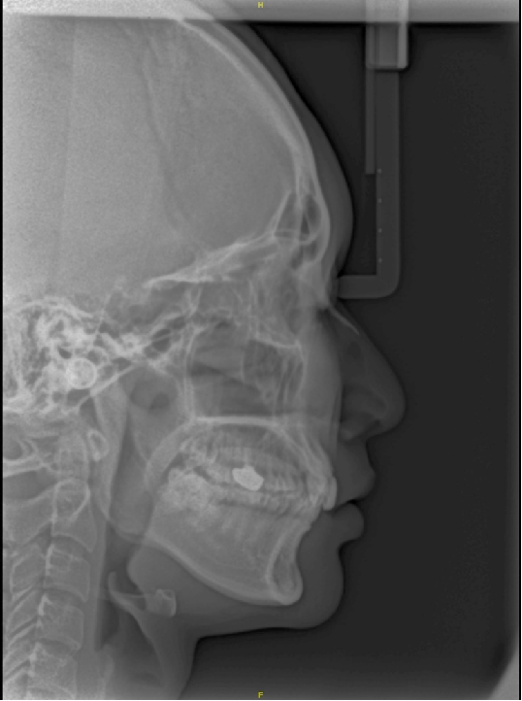
#7

Slide 20
#7

Slide 21
#7

Slide 22
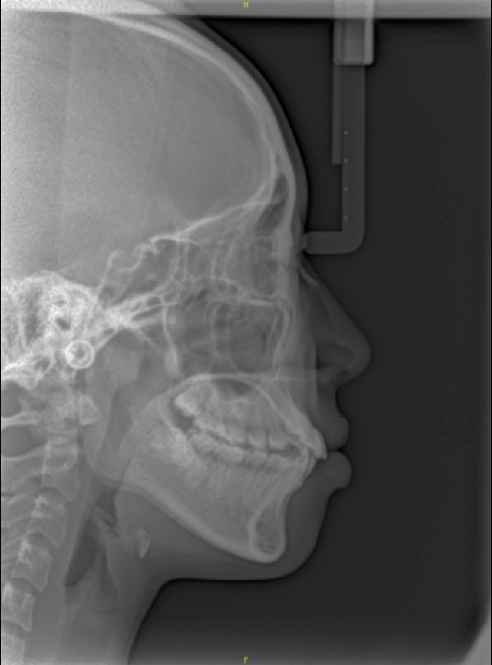
#8

Slide 23
#8

Slide 24
#8

Slide 25
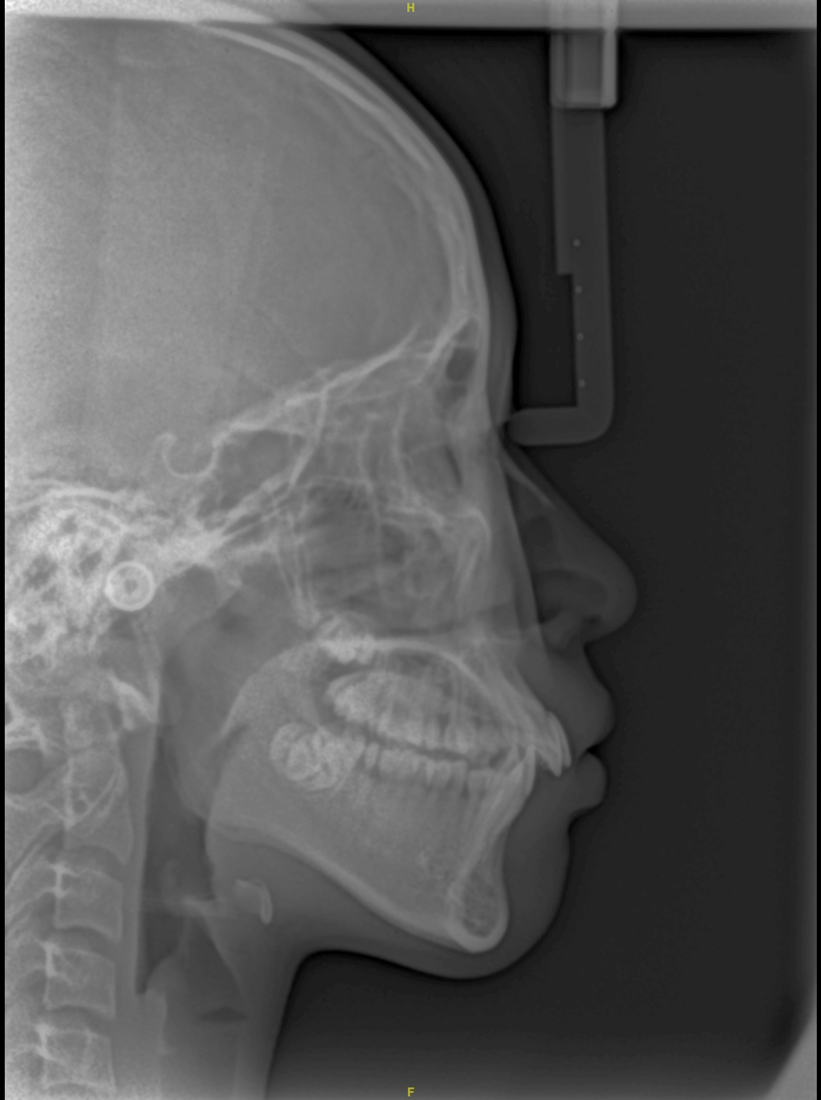
#9

Slide 26
#9

Slide 27
#9

Slide 28
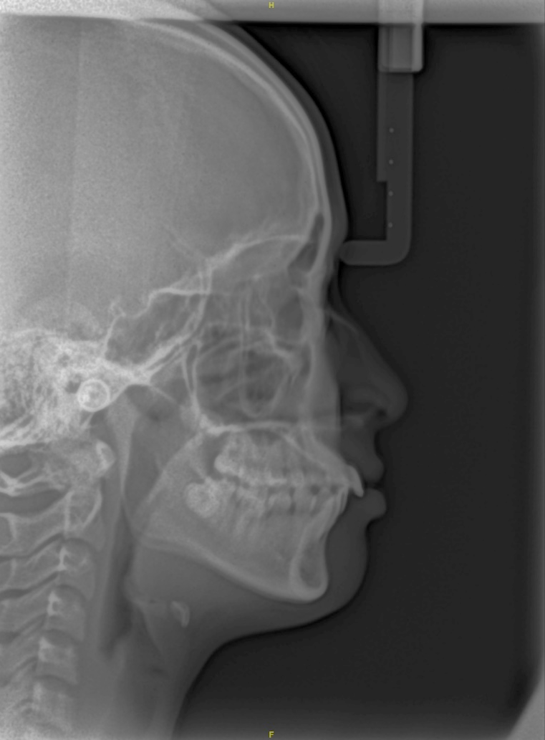
#10

Slide 29
#10

Slide 30
#10

